Slide 1
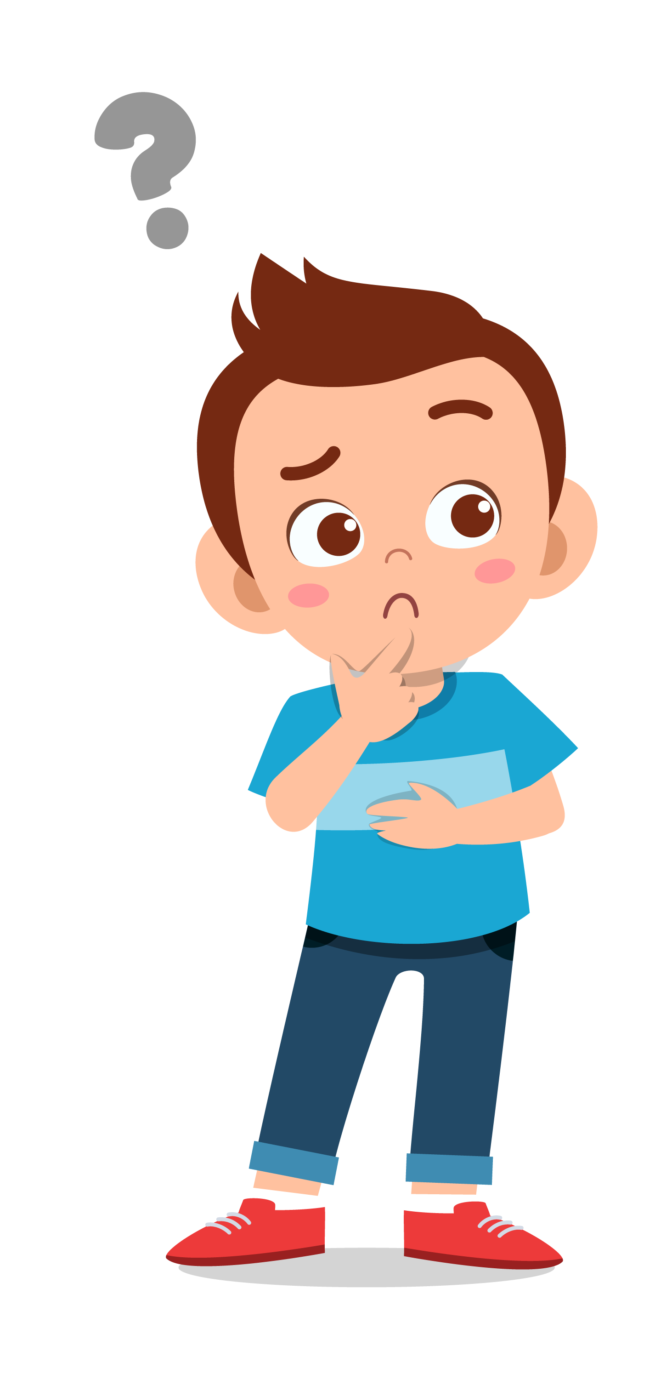
To Ask
For Help
lausd.org/human-relations

Slide 2
Would You Rather
Have tacos for lunch
Have pizza for lunch
lausd.org/human-relations

Slide 3
Use All Your Strength
lausd.org/human-relations
Notes:
https://www.youtube.com/watch?v=_ucrCVj0waI

Slide 4
Pair Share
Why do you think the speaker continued to say, “Use all your strength"?
lausd.org/human-relations

Slide 5
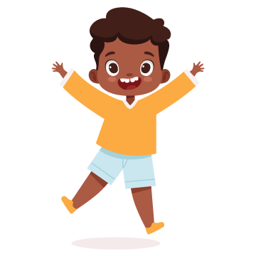
Giving vs. Getting Help
Helping others can:
Make you feel good
Help you feel important
Most people like to be helpful.
lausd.org/human-relations

Slide 6
Giving vs. Getting Help
Asking for help is not easy to do.
There are many reasons why people don't like to ask for help:
They get embarrassed
They don't want to be judged
The other person might say “no"
Most people want to do things on their own and be independent.
lausd.org/human-relations

Slide 7
Pair Share
Is it easier for you to give help or to ask for help?
lausd.org/human-relations

Slide 8
Normalizing Asking For Help
lausd.org/human-relations
Notes:
https://www.youtube.com/watch?v=yXz9aoHdnnk&t=1s

Slide 9
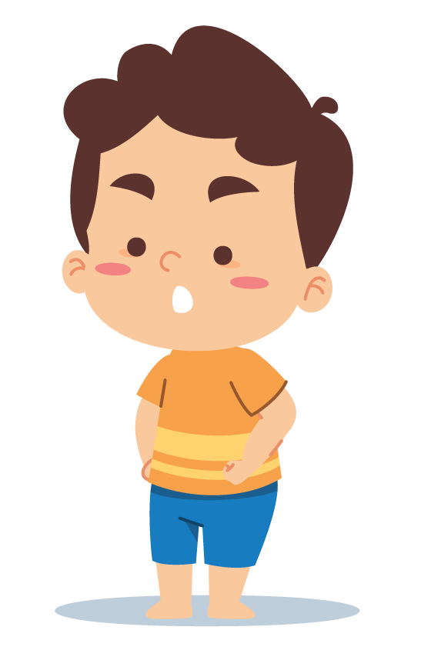
Best Ways To Ask For Help
Be Specific
Be Direct
Be Positive
Be Understanding
In Person
(34% more likely to get a "Yes")
lausd.org/human-relations

Slide 10
Who To Ask For Help From
Friends
Cousins
Coaches
Parents/Caregivers
Classmates
Teachers
Who can we ask for help?
If you are not used to asking for help, it can be hard to know who to ask!
lausd.org/human-relations

Slide 11
Pair Share
Who are you most comfortable asking for help from?
lausd.org/human-relations

Slide 12
Make A Choice
At least once a day you probably make a choice to ask for help or to do something on your own.
Everyone needs help from time to time.
Try to get in the habit of asking for help.
The more often you do, the easier it will become!
lausd.org/human-relations

Slide 13
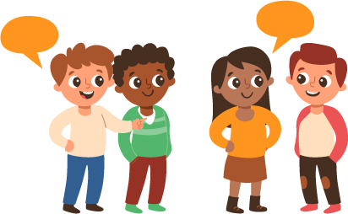
Discussion
What is something you can ask for help with today?
lausd.org/human-relations

Slide 14
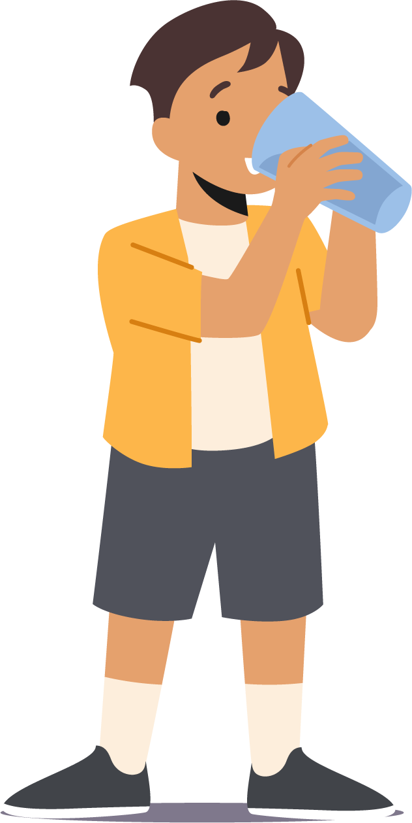
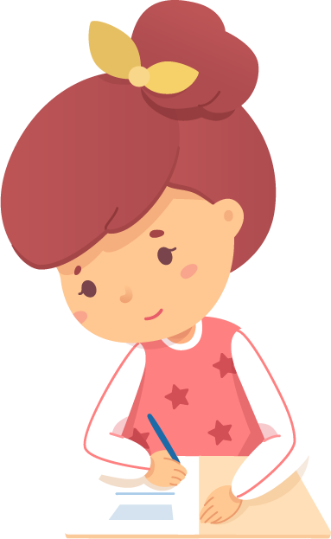
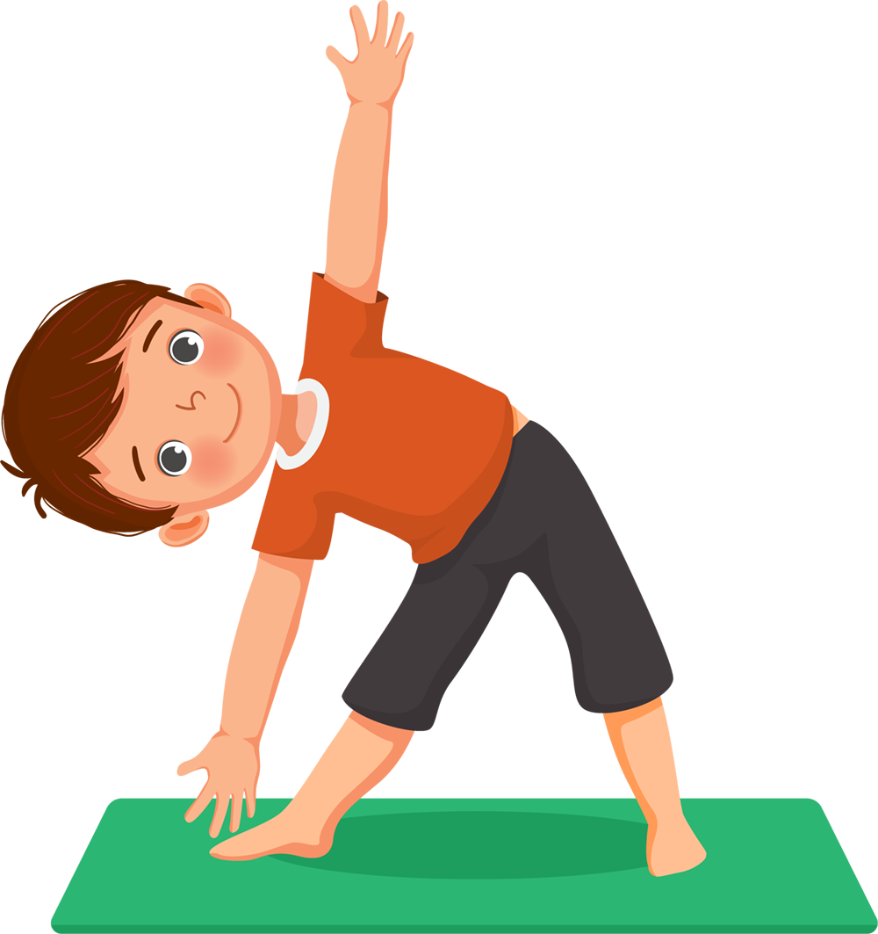
Check Out
What will you do for yourself today?
Sleep and rest well
Walk around your neighborhood
Stay hydrated
Listen to your favorite songs
Write in your journal
Workout

Slide 15
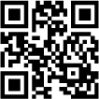
Committed to fostering a safe and respectful District, school and community culture where the seeds of peace and justice are down so that all students and staff can lead safe, purposeful and academically fruitful lives.
Connect with us at bit.ly/LAUSD-HRDE
lausd.org/human-relations

